Slide 1
Basics of Trees
EECS 233

Slide 2
Hierarchies Everywhere
Your local directory structure
Governmental and organizational structures
General approach of dealing with large-scale computer systems
  P2P networks
    Kazaa P2P network (peers and superpeers)
    Gnutella 2
  Hostnames
  IP addresses
  Internet
    Autonomous systems
    OSPF areas
Trees are natural representation of hierarchies

Slide 3
Flashback: Phone Book
Operations:
  search for an item (and possibly delete it)
  insert a new item
If we use a list (in previous lectures) to implement a data dictionary, efficiency = O(n).
Various tree structures allow for a more efficient phone book.
data structure | searching for an item | inserting an item
a list implemented using an array (sorted) | O(log n) using binary search | O(n) because we need to shift items over
a list implemented using a linked list | O(n) using linear search | O(1)

Slide 4
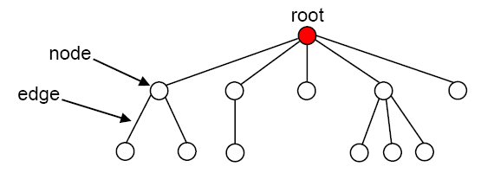
What Is A Tree?
A tree consists of:
  a set of nodes, with one of them distinguished as a root
  a set of edges, each of which connects a pair of nodes
  no cycles
Each node may have an associated data item (“payload”).
  consists of one or more fields
  key field = the field used when searching for a data item
The node at the “top” of the tree is called the root of the tree.

Slide 5
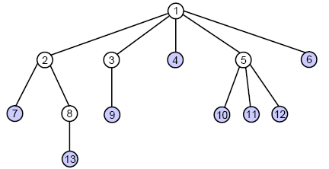
Relationships Between Nodes
If a node N is connected to other nodes that are directly below it in the tree, N is referred to as their parent and the other nodes are referred to as its children.
  example: node 5 is the parent
  of nodes 10, 11, and 12
Each node is the child of at most one parent.
Other “family terms”:
  nodes with the same parent are siblings
  a node’s ancestors are its parent, its parent’s parent, etc.
  a node’s descendants are its children, their children, etc.
A leaf node is a node without children.
An interior node is a non-leaf node (but sometimes meant as a non-leaf and non-root).

Slide 6
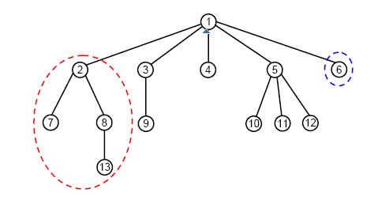
A Tree Is A Recursive Data Structure
Each node in the tree is the root of a smaller tree!
  refer to such trees as subtrees to distinguish them from the tree as a whole
  example: node 2 is the root of the subtree circled above
  example: node 6 is the root of a subtree with only one node
We’ll see that tree algorithms often lend themselves to recursive implementations.
Is an empty set of nodes a tree?

Slide 7
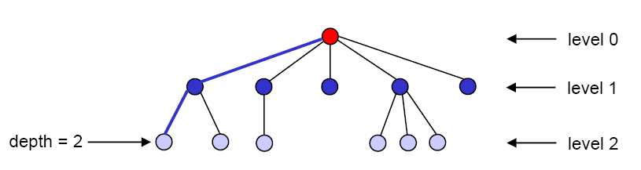
Path, Depth, Level, and Height
There is exactly one path (one sequence of edges) connecting each node to the root.
depth of a node = # of edges on the path from it to the root
Nodes with the same depth form a level of the tree.
The height of a tree is the maximum depth of its nodes.
  example: the tree above has a height of 2

Slide 8
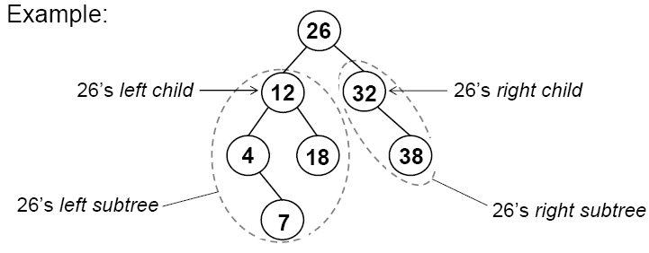
Binary Trees
In a binary tree, nodes have at most two children.
Recursive definition: a binary tree is a collection of nodes that is either:
  1) empty, or
  2) contains a node R (the root of the tree) that has
    a binary left subtree, whose root (if any) connects to R
    a binary right subtree, whose root (if any) connects to R

Slide 9
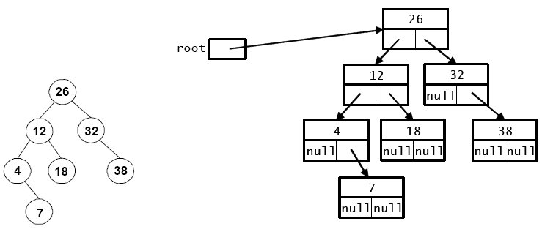
Binary Tree Representation in Java
  public class LinkedTree {
    private class Node {
      private int key;
      private String data;
      private Node left; // reference to left child
      private Node right; // reference to right child
      …
    }
    private Node root;
    …
  }

Slide 10
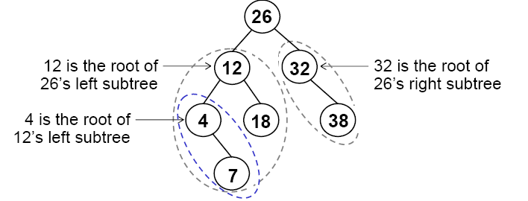
Traversing A Binary Tree
Traversing a tree involves visiting all of the nodes in the tree.
  visiting a node = processing its data in some way, e.g., print it
We will look at four types of traversals.
  Each visits the nodes in a different order.
To understand traversals, keep in mind the recursive definition of a binary tree: every node is the root of a subtree.

Slide 11
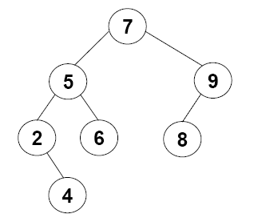
Preorder Traversal
Preorder traversal of the tree whose root is N:
  visit the root, N
  recursively perform a preorder traversal of N’s left subtree
  recursively perform a preorder traversal of N’s right subtree
Result:
7
5
2
4
6
9
8

Slide 12
Implementing Preorder Traversal in Java
  public class LinkedTree {
    …
    private Node root;
    public void preorderPrint() {
      if (root != null)
        myPreorderPrint(root);
    }
    private void myPreorderPrint(Node root) {
      System.out.print(root.key + “ ”);
      if (root.left != null)
        ?
      if (root.right != null)
        ?
    }
  }
    private class Node {
      private int key;
      private String data;
      private Node left;
      pivate Node right;
      …
    }

Slide 13
Postorder Traversal
postorder traversal of the tree whose root is N:
  recursively perform a postorder traversal of N’s left subtree
  recursively perform a postorder traversal of N’s right subtree
  visit the root, N
  Result: 4 2 6 5 8 9 7

Slide 14
Inorder Traversal
Inorder traversal of the tree whose root is N:
  recursively perform an inorder traversal of N’s left subtree
  visit the root, N
  recursively perform an inorder traversal of N’s right subtree
  Result: 2 4 5 6 7 8 9

Slide 15
Level-Order Traversal
Visit the nodes one level at a time, from top to bottom and left to right
AKA “breadth-first traversal”
Result: 7 5 9 2 6 8 4

Slide 16
Level-Order Traversal using Queue
  Initialization: insert the root in the queue
  while queue is not empty
  Remove a node from queue
  Print the node
  Insert each child into the queue
Result: 7 5 9 2 6 8 4

Slide 17
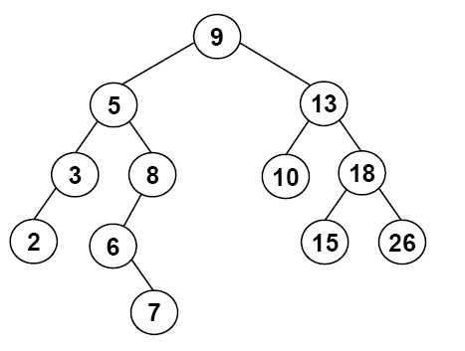
Tree-Traversal Summary
preorder: root, left subtree, right subtree
postorder: left subtree, right subtree, root
inorder: left subtree, root, right subtree
level-order: top to bottom, left to right
Perform each type of traversal on the tree below:

Slide 18

Back to Fibonacci:
Order-of-Traversal versus Recursive Calls
An execution of a recursive method forms a call tree
(though not an actual tree data structure)
  public static long fib( int n )
  {
  if (n <= 1)
  return 1;
  else
  return fib(n - 1) + fib(n - 2);
  }
  Analogy
    Recursive method invocation ≡ visiting a tree node
preorder: root, left subtree, right subtree
postorder: left subtree, right subtree, root
inorder: left subtree, root, right subtree
level-order: top to bottom, left to right
Q1: Recursive calls are pre-order, post-order, in-order, or level order?
Q2: How much stack space is needed for the execution?
  Or, would fib(1000) cause stack overflow?

